Slide 1
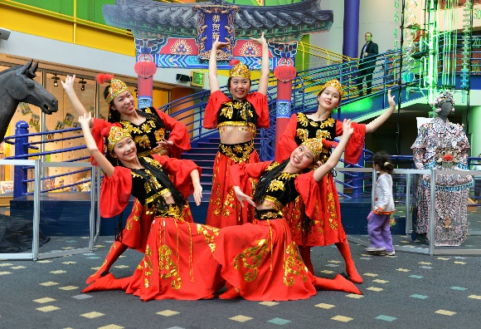
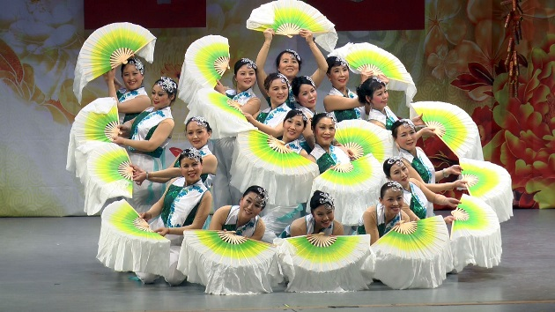
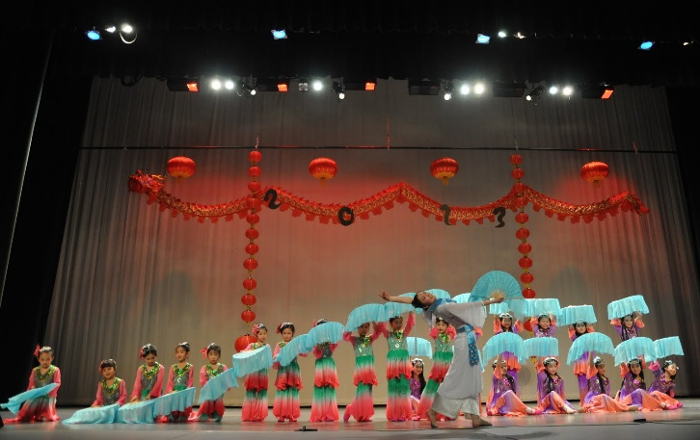
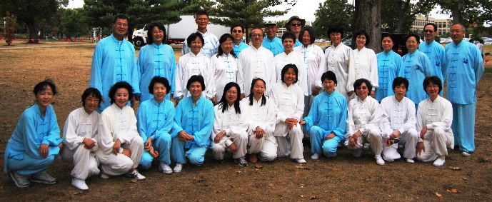
ICPAI 10th Anniversary
Year of the Goat Celebration
Time: Saturday, January 31, 2015, 4 - 8 pm,
Address: Zionsville West Middle School,
5565 S. 700 East, Whitestown, IN 46075 (Entering through Door #4 on south side of the building)
Admissions: (Pay at the door)
ICPAI members/families & invited guests (free)
Public guests: $5; Ages under 10 or over 65: $3
Registration or questions: icpai2015@gmail.com
Event Activities:
4:30-5:30PM - Snacks, Social, ICPAI 10-year anniversary slides show and speeches
5:30-7:30pm - Stage performance by ICPAI and guest performers
Sponsors
Eli Lilly and Company Foundation
Eli Lilly Chinese Culture Network (CCN)
City of Indianapolis
City of Carmel
Citizen Gas Indianapolis
David Williams Russell, Attorney
Confucius Institute in Indianapolis
West Middle School of Zionsville
LEWIS KAPPES Attorneys At Law
Asian American Today

Slide 3
印城中华艺术团 Indianapolis Chinese Performing Arts, Inc. (ICPAI) http://www.indychineseperformingarts.org
Miles Stones:
2003 – Show Group as a lady’s club
2004 – Filed for nonprofit registration application
2005 – 501(C)(3) established as ICPAI
2005 – ICPAI has two subgroups – Show and Taiji
2008 – Little Flower Group was formed under ICPAI
2012 – NewGen joined ICPAI
Current ICPAI Functional Groups:
ICPAI Show and Performance Group 印城中华表演队
ICPAI Tai Chi Group 印城中华太极队
ICPAI Little Flower Group 印城中华小红花队
ICPAI NewGen Group

Slide 4
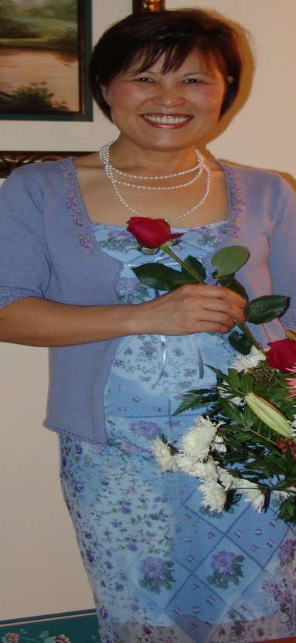
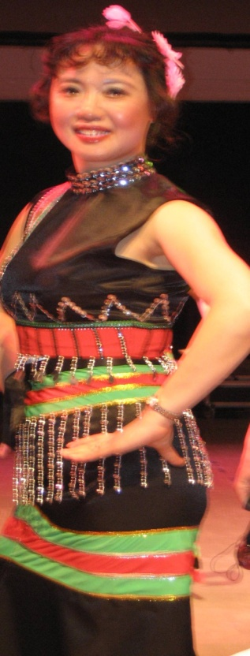
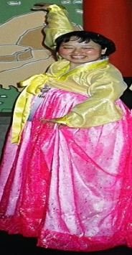
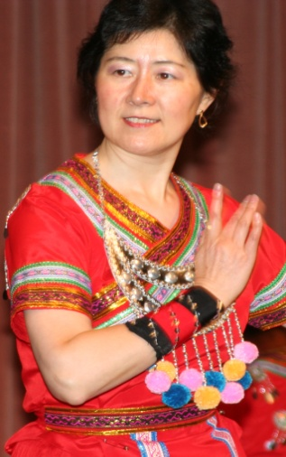
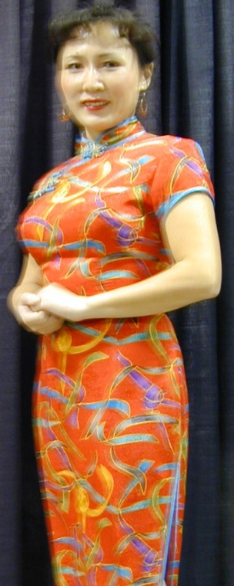
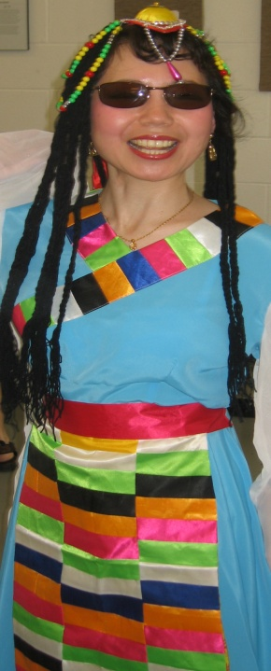
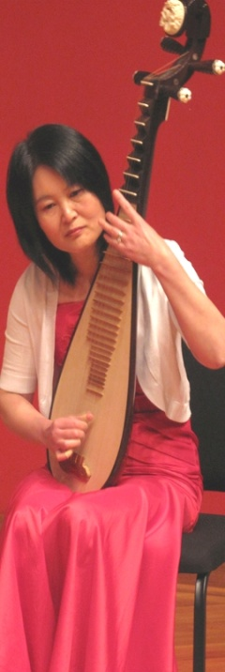
ICPAI Past & Current Board Members (2004 – 2014 in order)
President - Xin Min Yue
Vice President/Sectary – Jirong Lu, Faith Du, Ling Liu, Ping Yi
Treasure - Yuan Su, Nasha Huang, Ling Liu, Tina Magnusson
Art Director – Yueru Zhang
Communication – Hong Zeng

Slide 5
Functional Group Chairs
2003-2014 in Order
Show Group – Peiyi Hu, Ling Liu, Xin Min Yue, Nasha Huang, Hong Zeng, Ching Li, Nasha Huang
Taiji Group – Faith Du, Hongbo Lin
Little Flower Group – Yueru Zhang
NewGen – Wei Zeng
Instructors
Show Group – Miao Xu, Yueru Zhang, Weihong Lei, Jianghong Li, Ching Li
Taiji Group – Faith Du
Little Flower – Yueru Zhang, Shan Guan, Chen Ni, Tina Magnusson, Fancy Chase
NewGen – Guan Shan, Chen Ni
Costume management
Yanyan Chen
Xiu-Juan Yuan

Slide 6
Collaborators
Eli Lilly Chinese Culture Net Work (CCN)
Confucius Institute in Indianapolis
Indianapolis Hangzhou Sister Committee (IHSC)
Indianapolis Chinese Community Center Inc. (ICCCI)
IUPUI Chinese School
Indiana American Chinese Association (IACA)
Indiana Chinese Physician Association

Slide 7
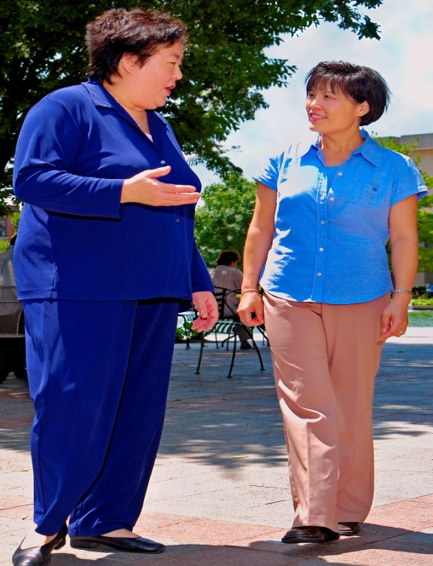
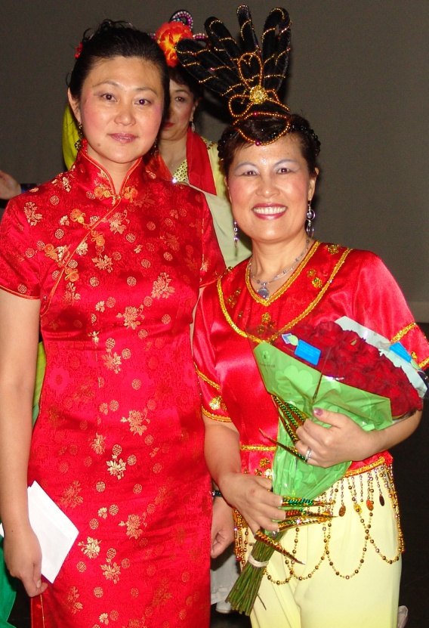
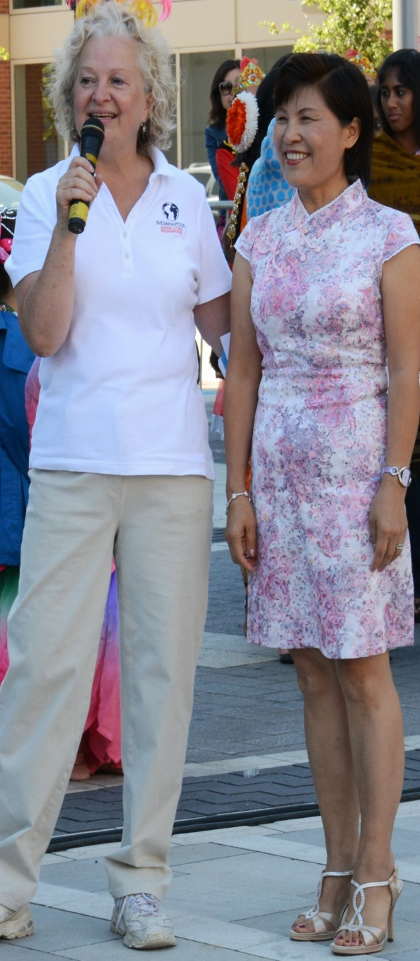
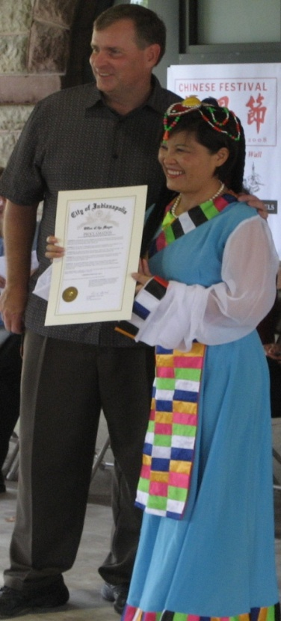
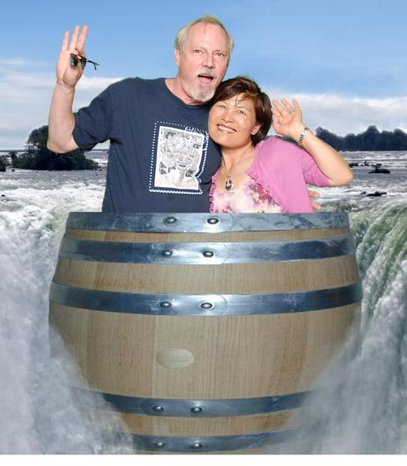
Most Influenced
Dr. Pamela Anderson
– Advisor to Xin Min on nonprofit organization estblishment
May 2004
Sherry Dong – 2008 CCN Chair brought ICPAI to Butler Stage
Jane Gehlhausen – Provided ICPAI a bigger stage to connect to International Community
Mayor Ballard – Made the Chinese Community Shine in Indianapolis
Bill Cady – Donated the initial funds for ICPAI to start

Slide 8
ICPAI Volunteering Activities
Collaborated with over 50 organizations
Performed for over 250 events
Major Events
International Festival at Indiana Fair Ground
Lilly Diversity Month and CCN Chinese New Year Gala
Indy 500 Parade
Indianapolis Children’s Museum
ICCCI Chinese New Year Gala
Asian Festival - Garfield Park
Carmel International Festival
Indianapolis Chinese Festival – Military Park
Indianapolis Sister City Festival at Gorge Street
Special Events
CCN Year of OX Celebration at Clowes Memory Hall
Pacers/Rockets NBA Game Pre-show Performance
China earthquake relief fundraising event – Madam Walker Theater Center
United Way Conference - Downtown Hyatt Hole-Regency
Carmel Senior Home
Purdue University, West Lafayette
Indiana University, Bloomington
SAINT MARY-OF-THE-WOODS Church, Terre Haute
Brownie Troop 42 at Lutheran Church King of Glory
Greenfield City and Churches Asian Culture Celebration

Slide 9
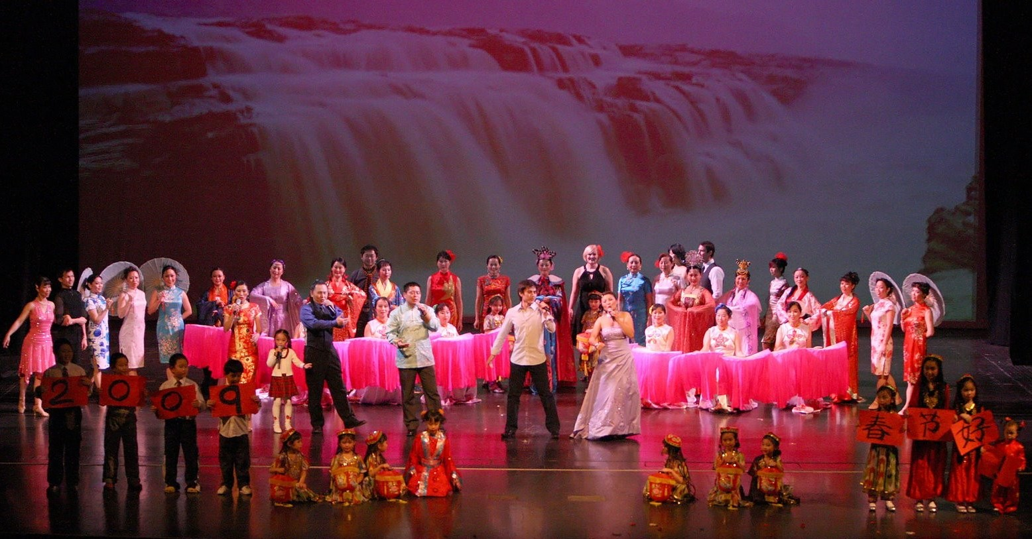
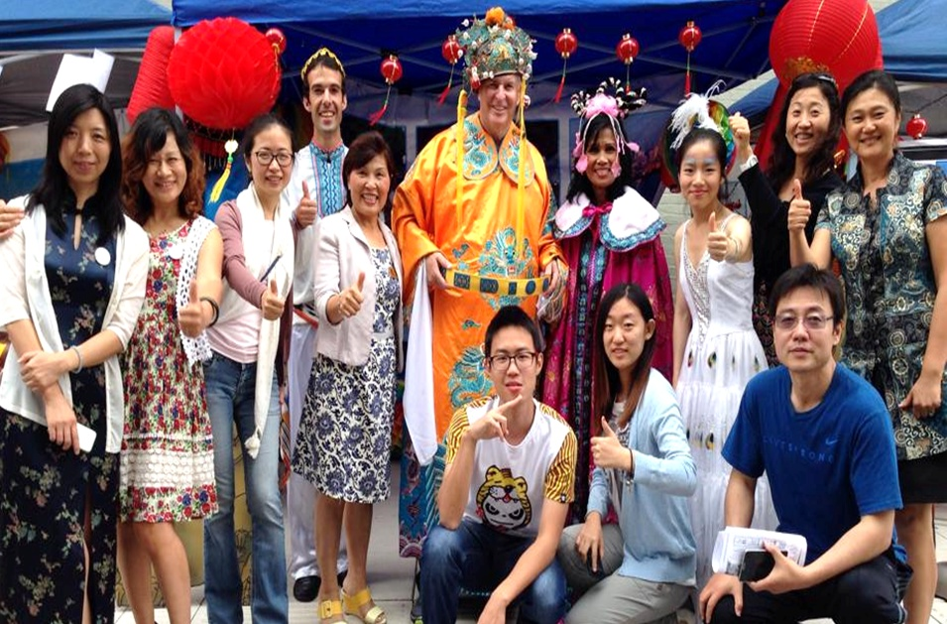
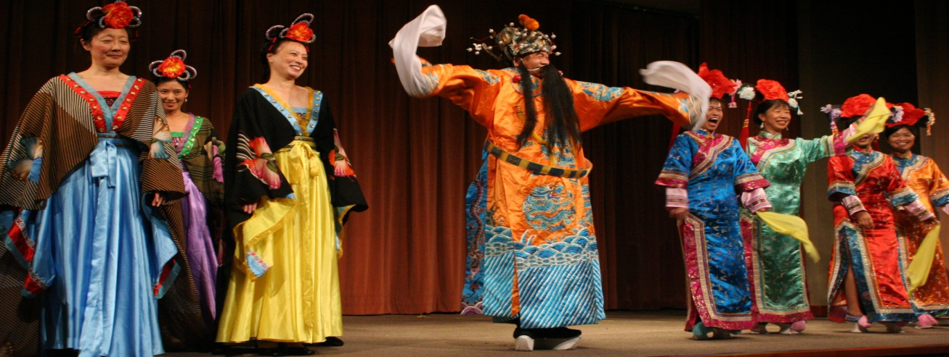
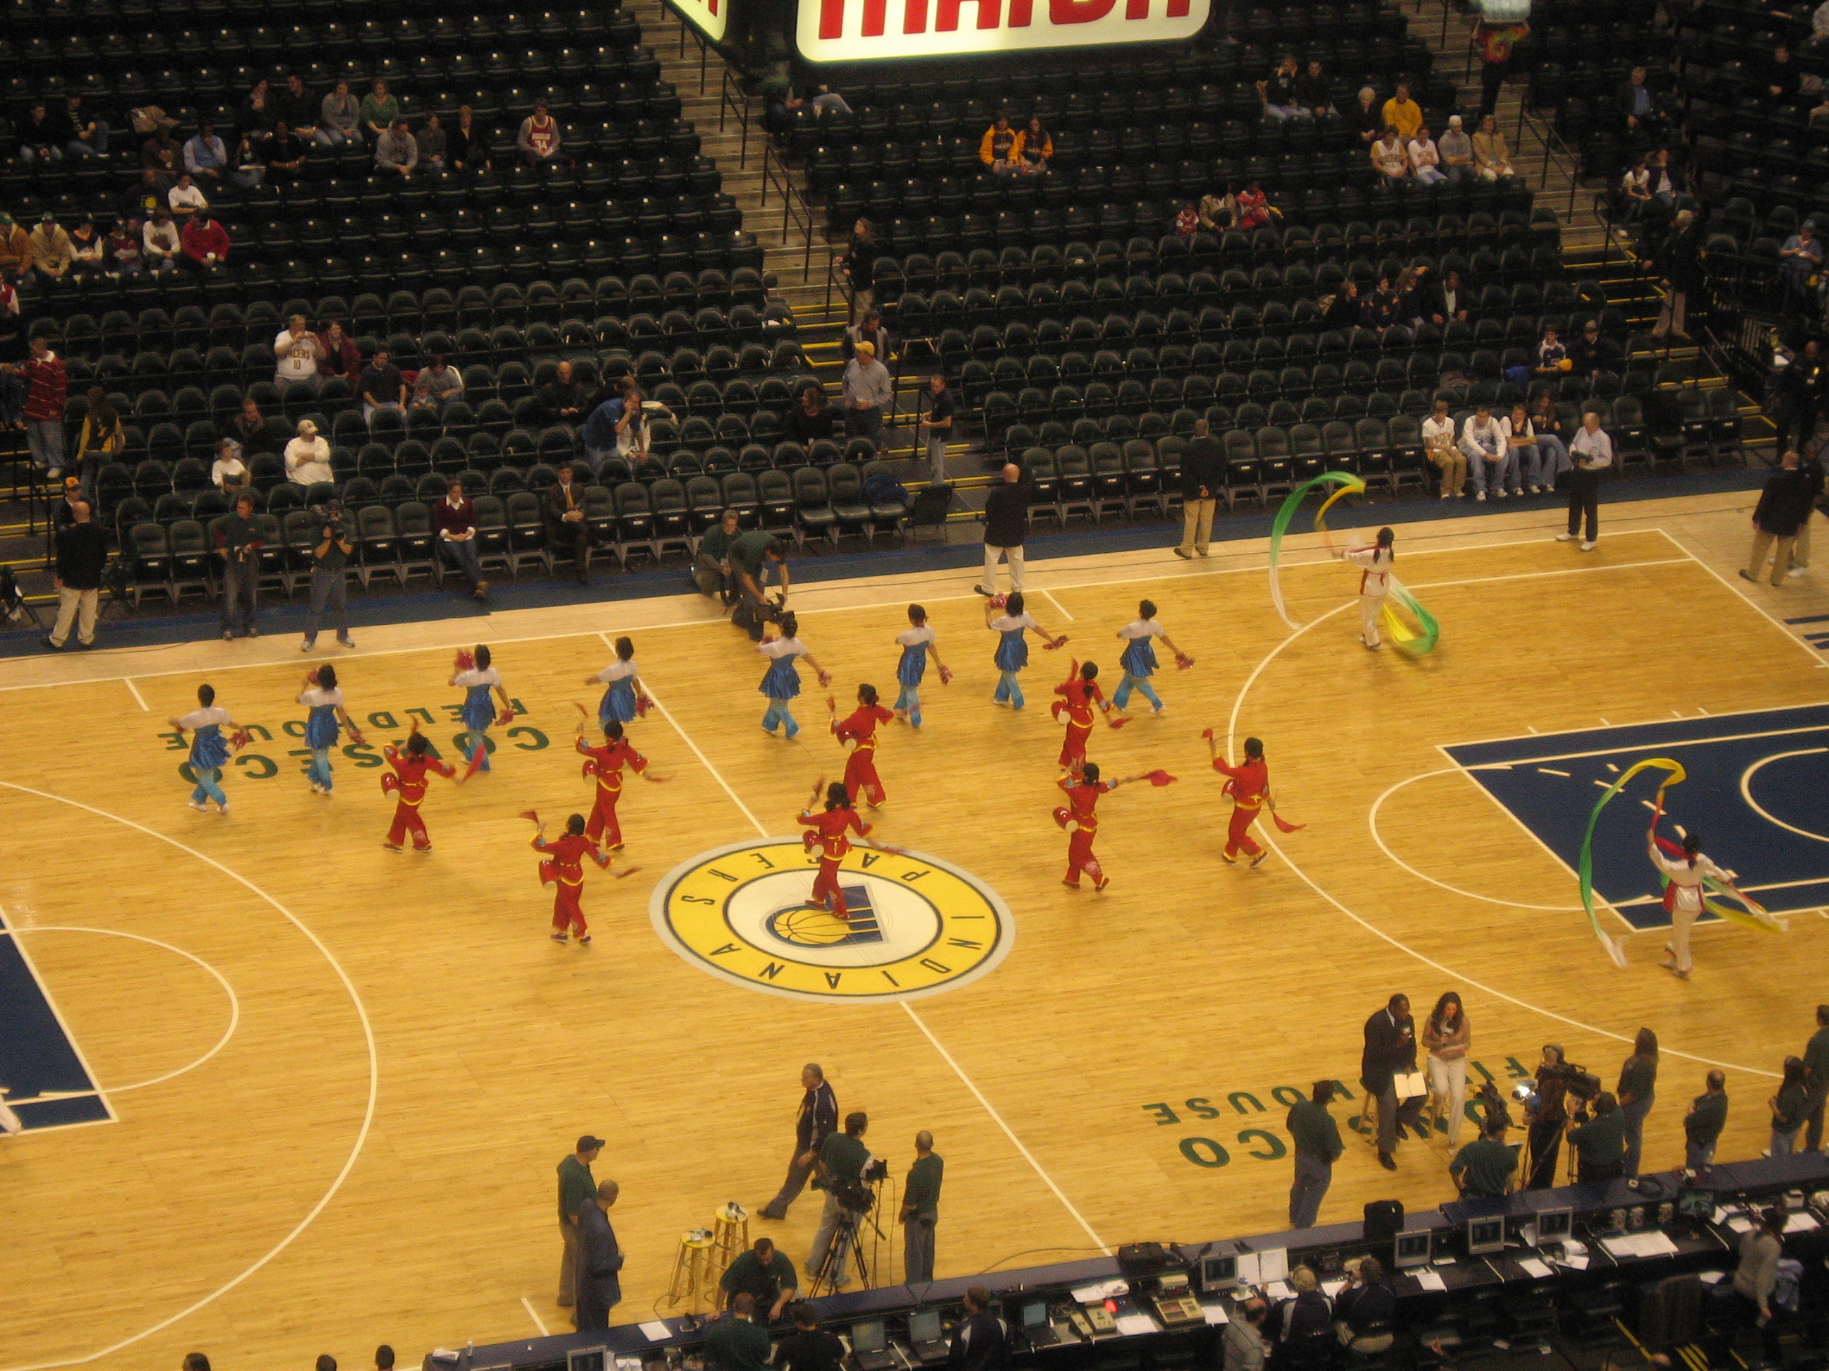
Highlighted Events
Indy 500 Parade, 2011
2008 – Clowes Hall with 1500 audience
Indy 500, 2004
Sister City Festival, 2014
Eli Lilly Diversity Month, 2004
NBA Game at Conseco House
Take Me There – China at Children’s Museum, 2014
Indianapolis Chinese Festival, 2014

Slide 10
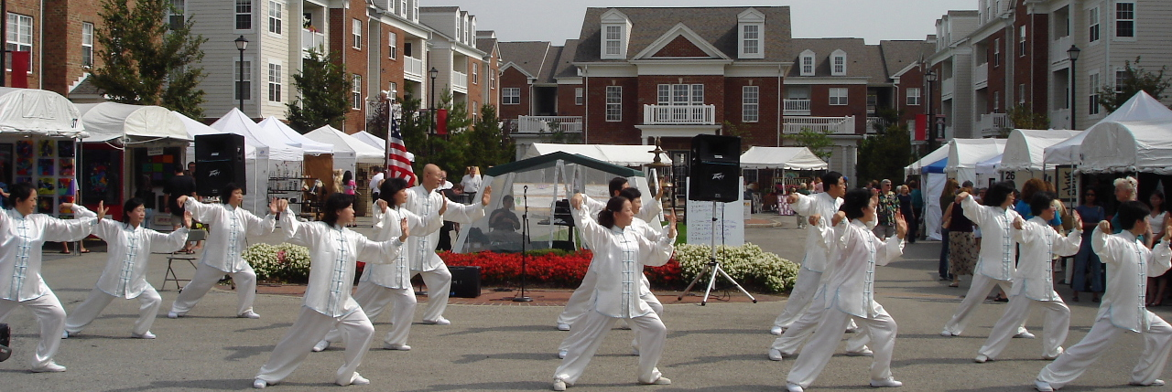
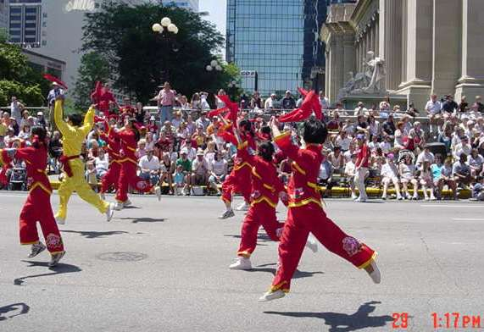
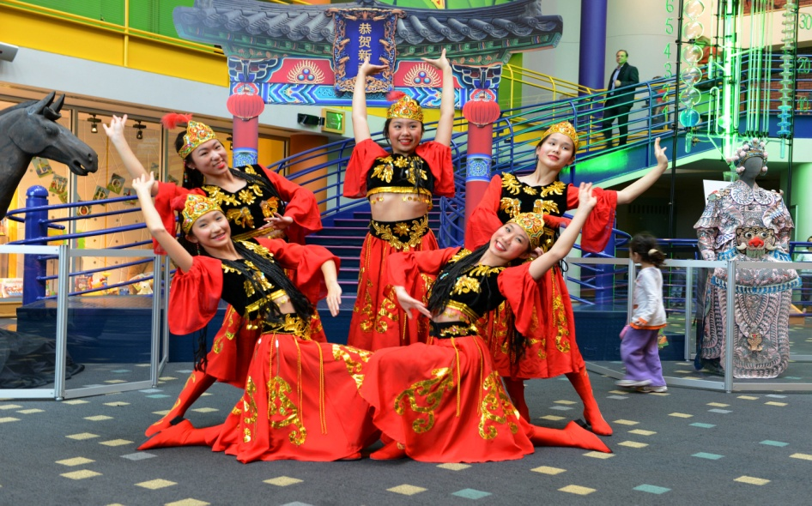
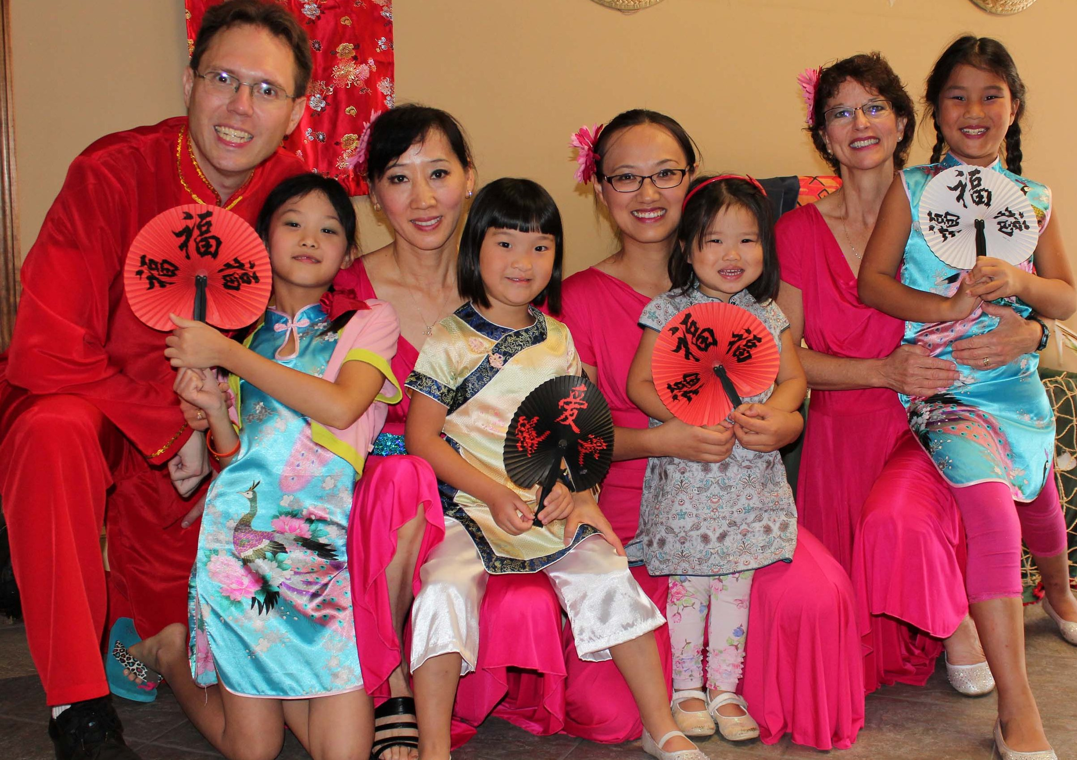
Special Memories
First Carmel International Festival
First Joining the Indy 500 Parade
Take me there China at Children Museum
On the Same Stage with Mom & Dad

Slide 11
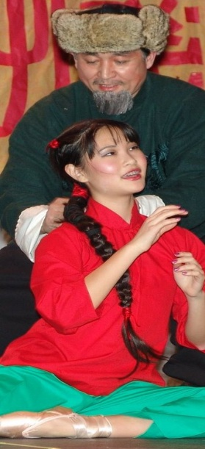
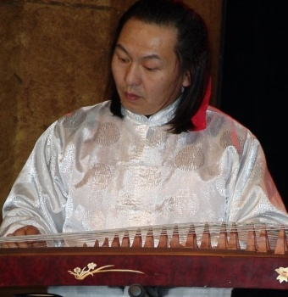
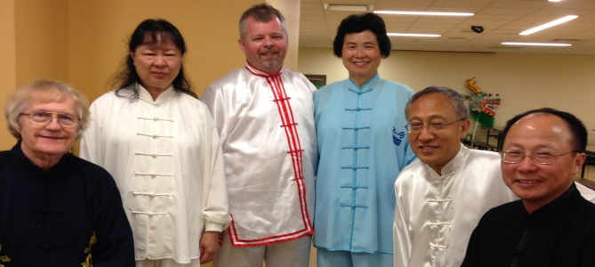
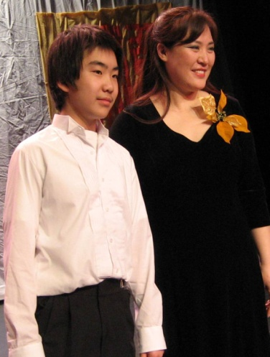
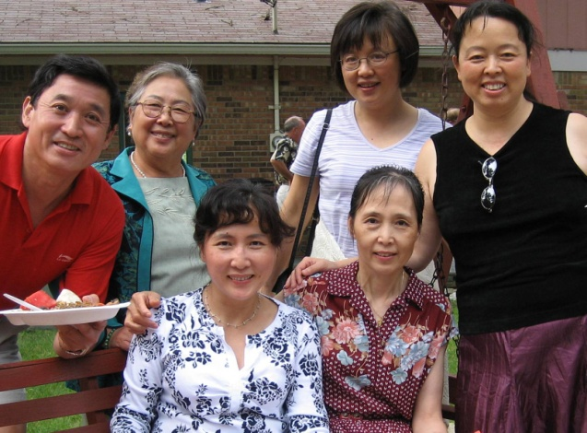
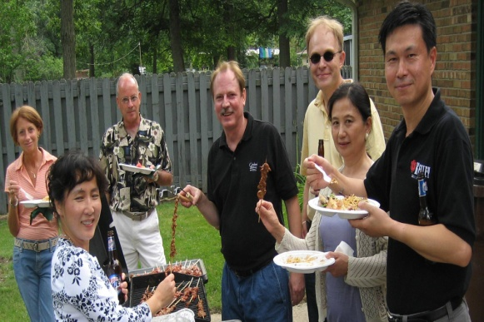
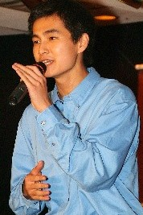
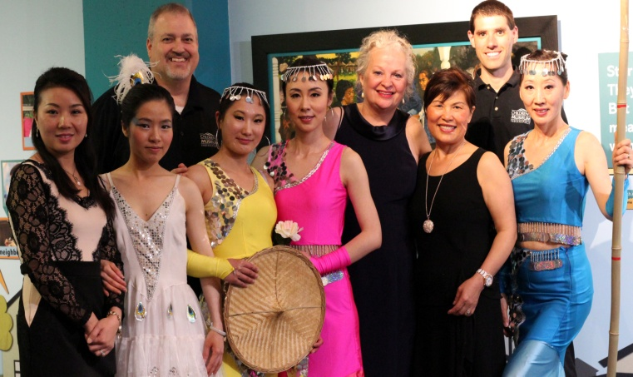
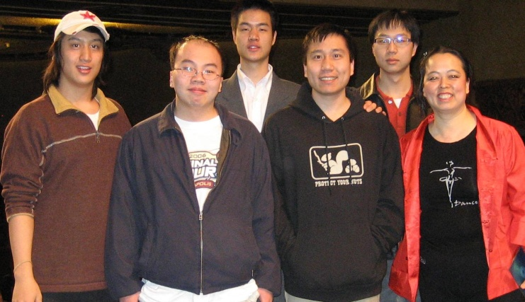
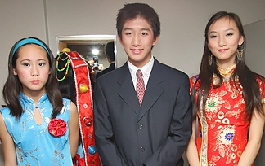
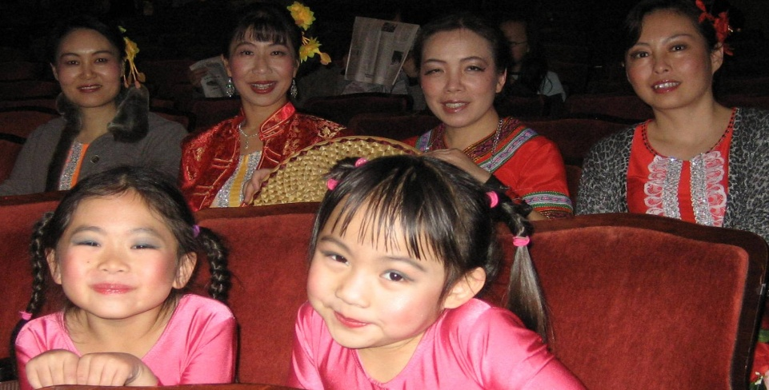
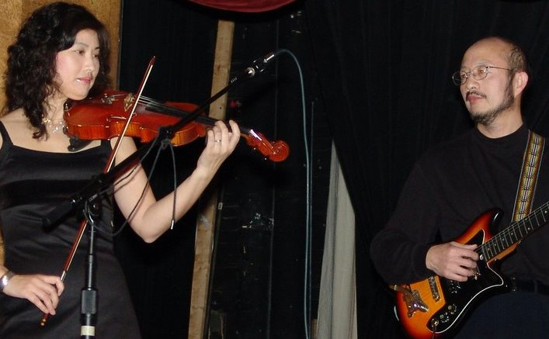
Sincere Appreciations
All ICPAI Leaders, Instructors, Performers and Volunteers
ICPAI Member’s Parents, Spouses, and Families
Sponsors
Advisors
Collaborators
VIPs
All Guests & Friends
Work together to build a strong and better community!
Strive for Another Decade!

